Slide 1

Banking Data & AI Hackathon

Slide 2
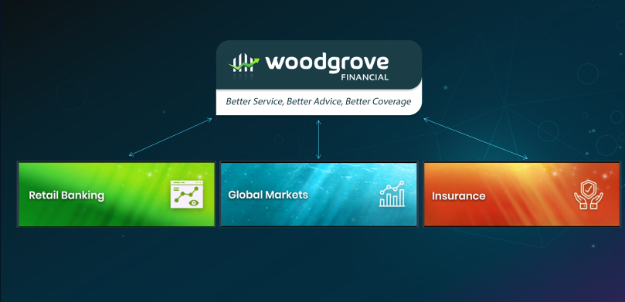
Case Study
Woodgrove Financial are a global Financial Conglomerate, with multiple operational arms.
Headquartered in New York, they are operating in 30+ cities all over the world. But their growth is currently stalled.
They aim to increase revenue, maximize active customers, and improve their public image by leveraging near real-time data and Predictive Analytics.
As part of this hackathon you will be presented with 3 business challenges that Woodgrove’s banking vertical is trying to solve through Azure technologies.
As solution provider your aim is to build an end-to-end MVP to solve these challenges.

Slide 3

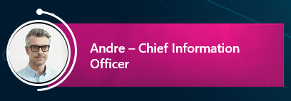
Challenge 1 : Automated Document ingestion system
Chief information officer Andre is responsible for making sure that all Customer data is ingested properly and is available for any other application or organization.
A large portion of information submitted by customers comes in either handwritten or scanned forms. Woodgrove spends manual labor hours to scrape and digitize the data.
The manual process has slowed down the pace of business and adds significant cost. To enhance the customer experience and cut expenses Andre is looking to use Artificial intelligence and other Azure services to automate this process.

Slide 4
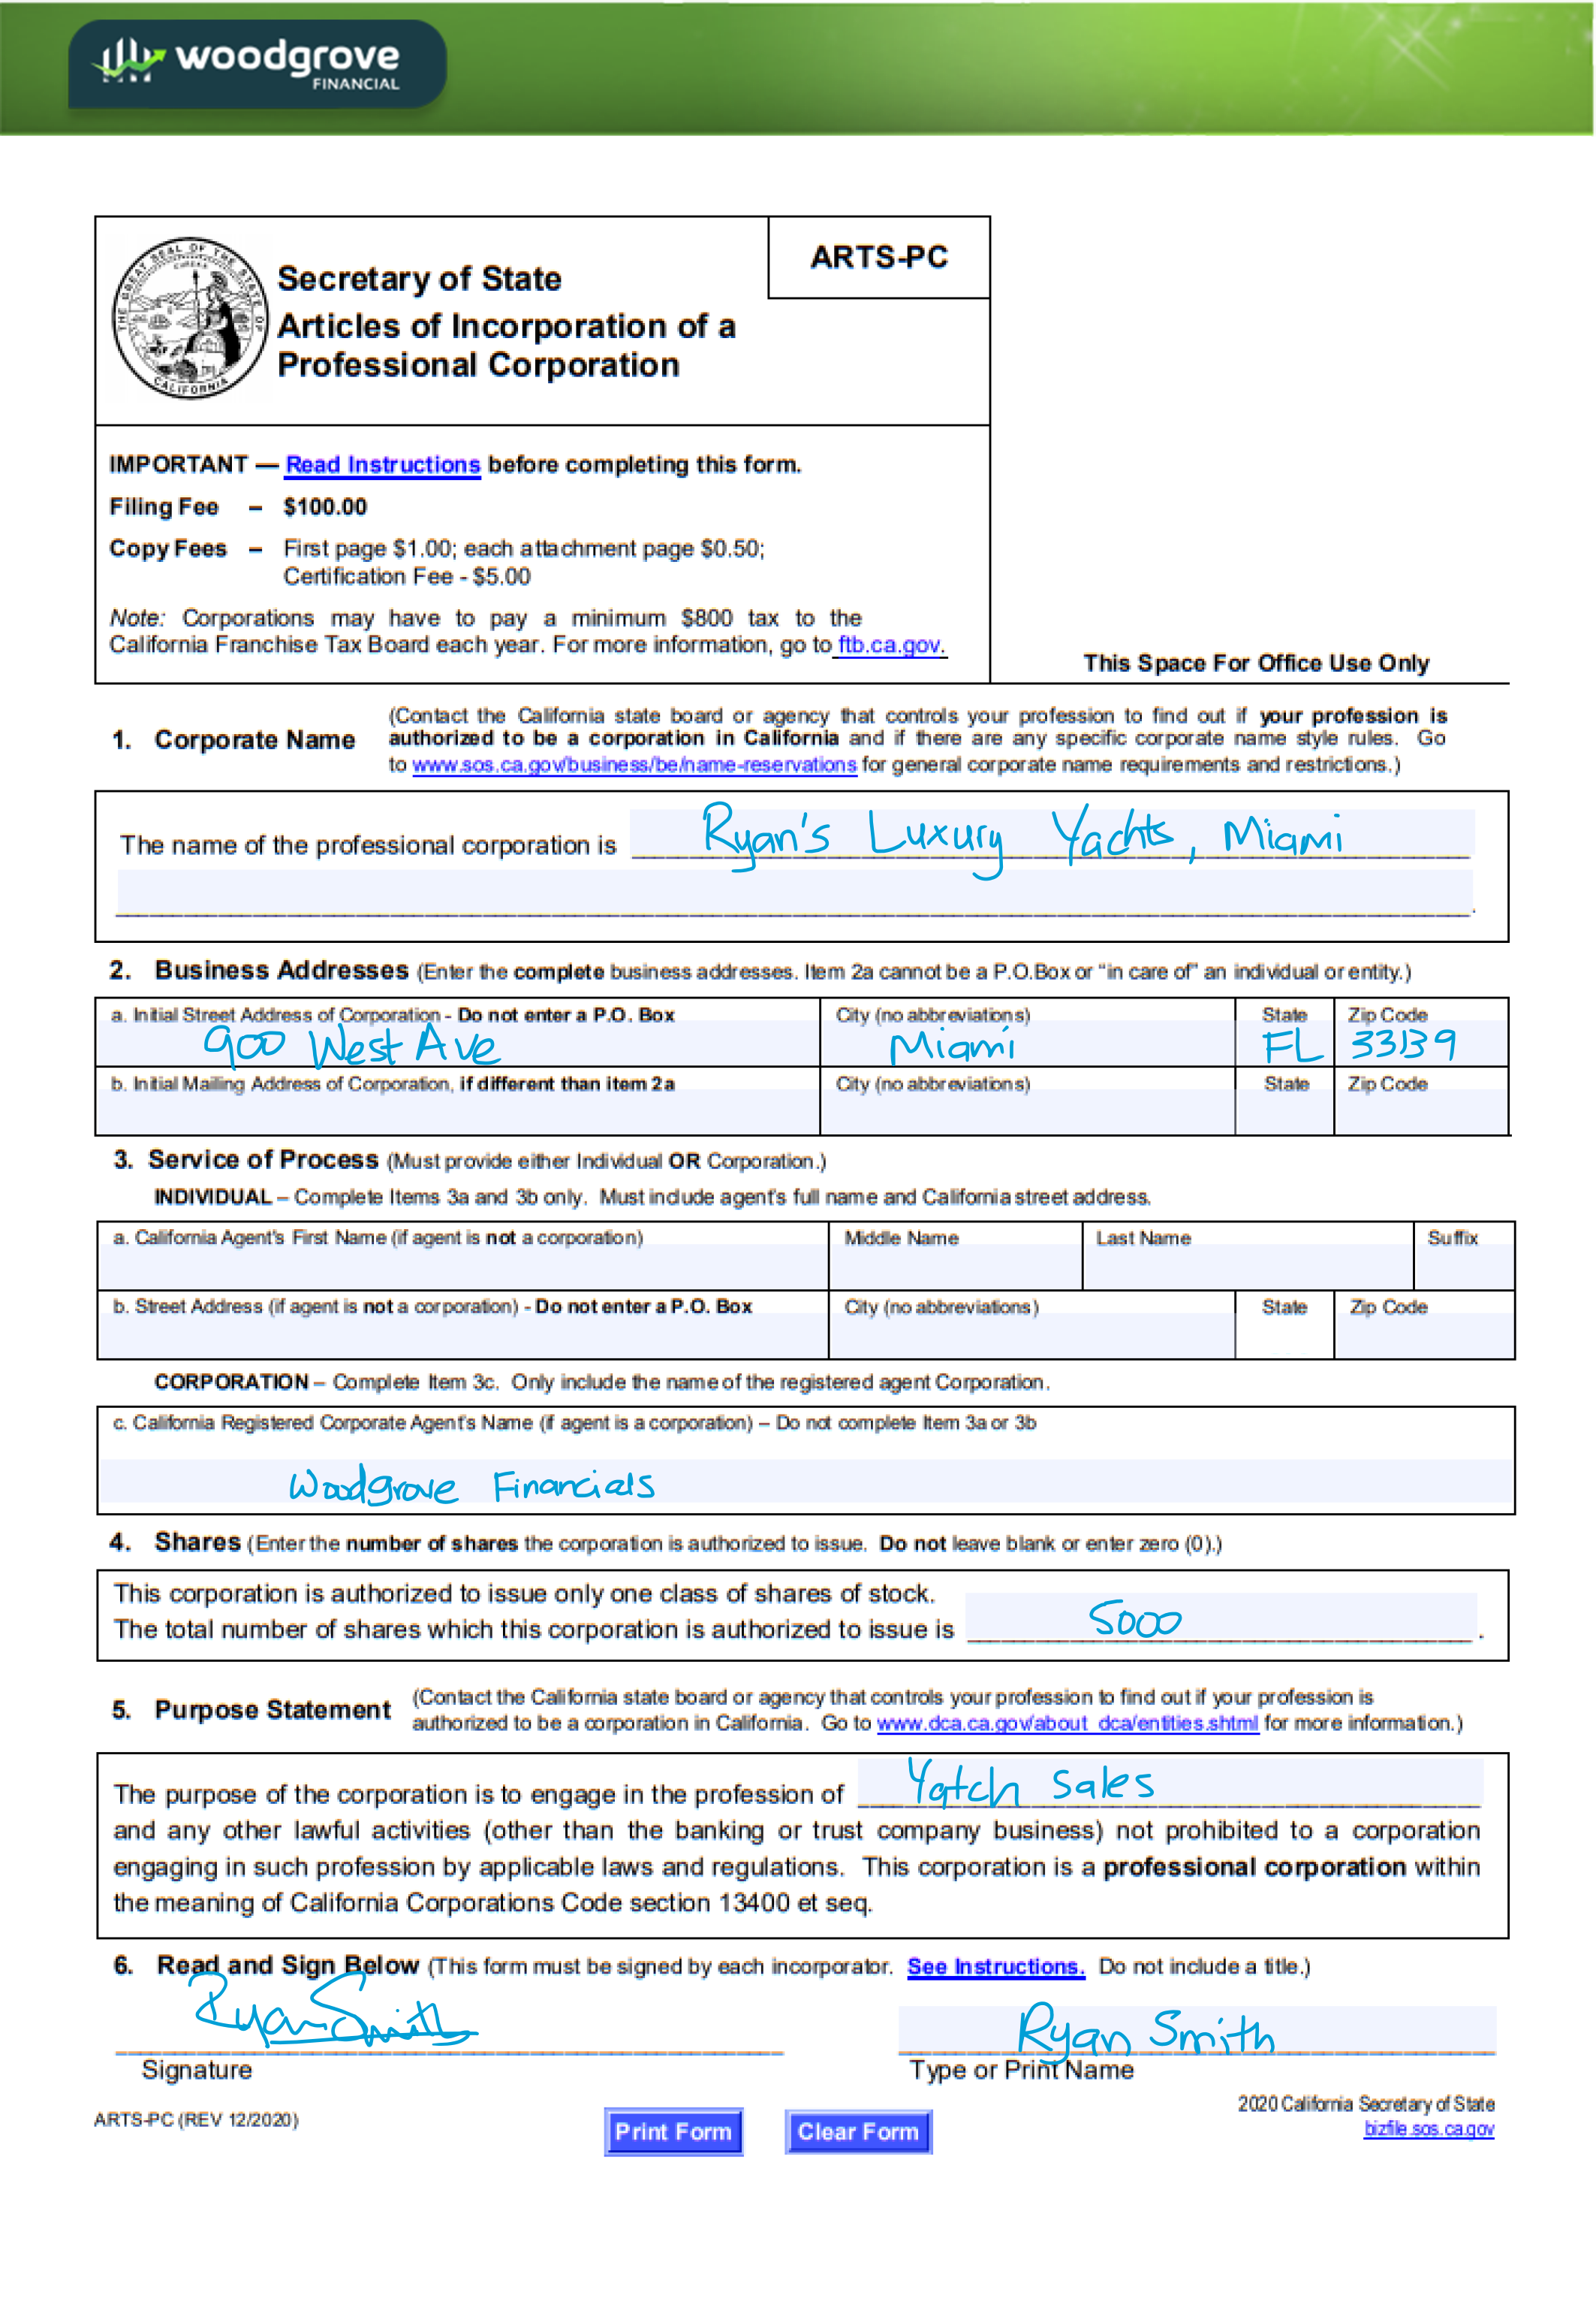
Challenge 1 : Automated Document ingestion system - Artifacts
Sample Data
Incorporation of Professional Corporation Form
5 Sample forms available for training AI models
Fields Needed
Name of the professional corporation
Address
City
State
Zip Code
Agent Name
Number of Shares
Signed Name

Slide 5





Challenge 1 : Automated Document ingestion system - Architecture
Mail
Storage
Logic app
Form Recognizer
Webapp
Azure Services
Storage Account
Logic App
Forms Recognizer
Downstream applications
that use scraped digital data
Upstream application
For document upload

Slide 6
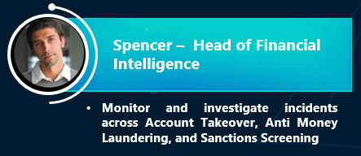
Challenge 2 : Fraud and real time reporting
As head the head of financial intelligence, Ryan is constantly looking for ways to recognize and prevent fraud as soon as possible.
With the rise in cybercrimes Spencer has leant that, but he needs to find a way operationalize this data detect fraud in real time.
Another part of his job is to make sure Office of Foreign Assets Control ("OFAC") data is reported US department of treasury. However, since most ETL jobs on these transactions are run in a daily batch reports are often delayed. Ryan is looking to create an OFAC dashboard that can display this information in real time.

Slide 7




Challenge 2 : Fraud and real time reporting
Data Source
Ingest
Serve
Consume
User
Scored
Transactional Data
To Cosmos
Transactional store
Cosmos HTAP
Synapse Link
To Cosmos Analytical store
Data Warehouse
Power BI
Cosmos

Slide 8
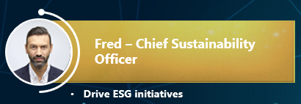
Challenge 3 : ESG analytics and deep dive
Fred is responsible for designing and implementing ESG initiatives at Woodgrove Financial. In recent times, chief customer officer has complained that churn rate is among the younger customers is high due Woodgrove’s poor ESG performance.
Fred would like to understand ESG performance of the Woodgrove compared to it’s competition and the Market.
He also wants to dig deeper into Woodgrove’s ESG assets to be able to find key factors behind poor ESG performance and options for remediation.

Slide 9







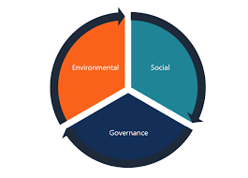
Challenge 3 : ESG analytics and deep dive Architecture
Data Source
Ingest
Storage
Processing
Serve
Consume
User
Polybase
Pipeline
Power BI
Data Lake
Synapse Notebooks
Data Warehouse
Twitter
Portfolio
Notebook
10K/10Q
Notebook
Cognitive Services – News & Text Analytics
News

